Slide 1


Abstra
Lazar Milicevic
Weekly support report
Support, Challenges, Sollutions
04.03.2025

Slide 2
Agenda
1. Zendesk Support & Performance Update
3. Abstra Onboarding Documentation Review
5. Next Steps & Focus Areas
2. NPS Tool Implementation Progress
4. Challenges & Solutions
6. Q&A

Slide 3

Zendesk Support & Performance Update
Customer success: Weekly Support Report – 11.03.2025
What was done:
✅ Maintaining fast response times – First response time remains below 15 minutes for every ticket.
✅ Handling L2 tickets – Actively working on whitelisting domain requests, ensuring smooth access management.
✅ Dataset Creation Form Enhancement
Working to solve Zendesk’s lack of multiselect fields support with custom JavaScript.
Ensured real-time submodalities updates based on user selections.
Fine-tuning ongoing for seamless dataset request handling.
🚀 Continued focus on speed, accuracy, and process automation.

Slide 4
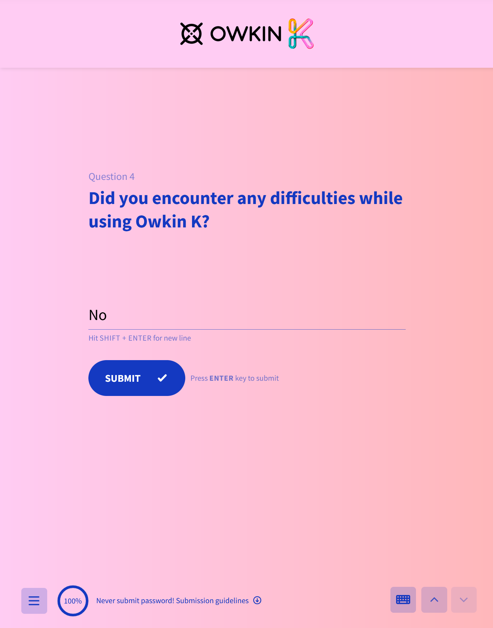
NPS Tool Implementation Progress
Customer success: Weekly Support Report – 11.03.2025
Where we are now ?
NPS Tool Implementation Progress
✅ Meeting with Jeremy (Frontend Developer) – Walked him through the SurveySparrow widget, explained platform functionalities, and granted him access.
✅ Approval from Adi – Confirmed that SurveySparrow will replace the current Owkin K feedback widget.
🚀 Status: Implementation is now in progress.

Slide 5
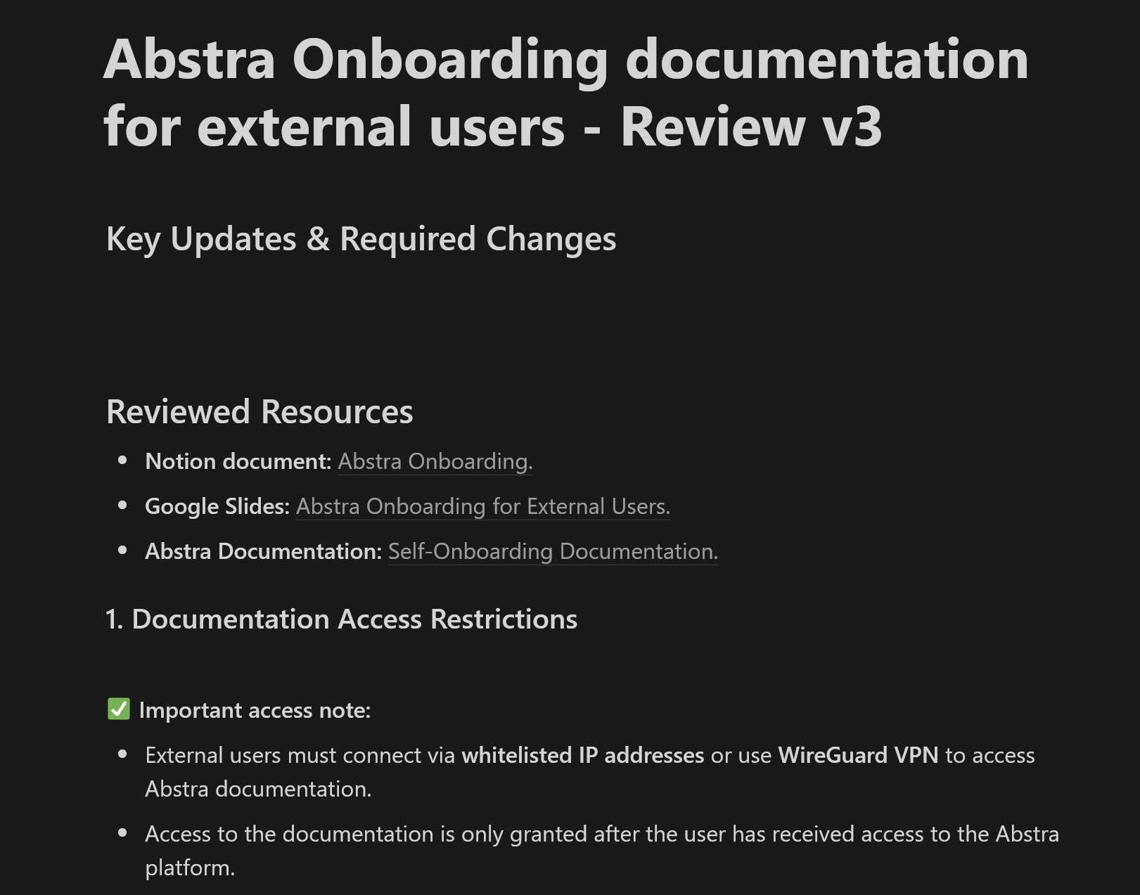
Abstra Onboarding Documentation Review
Customer success: Weekly Support Report – 11.03.2025
Where we are now ?
✅ Reviewed and identified necessary updates in onboarding materials for external users, ensuring alignment with current workflows and access requirements.
📌 Documents reviewed:
Google Slides (Abstra Onboarding Presentation) – Checked slides for outdated UI elements, roadmap
adjustments, and dataset management process updates.
Abstra Documentation (Self-Onboarding Guide) – Assessed Projects & Workspaces, Dataset Workflow, and Complete Datasets sections for necessary revisions.
Changelog Verification – Ensured all 2025 changes are accurately reflected in documentation.
✅ Finalized report – The full report is now available on the Notion page.
🚀 Next Focus: Owkin K Documentation
Owkin K is set for internal launch on March 31, so documentation must be fully prepared by then.
Meeting today with Adi Ravia and Adrien Darbier to align on priorities and next steps.

Slide 6
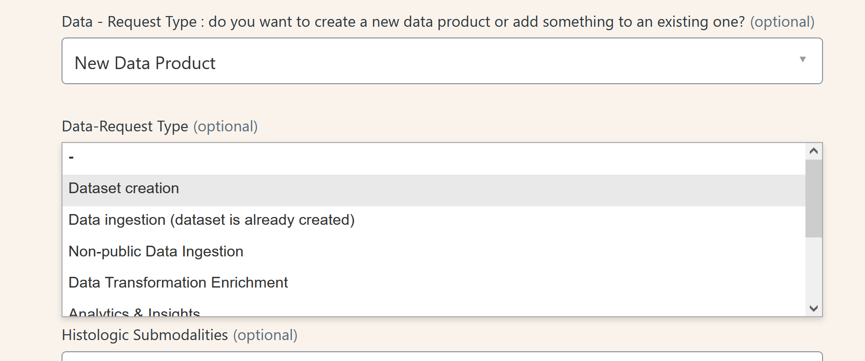
Challenges & Solutions
Customer success: Weekly Support Report – 11.03.2025
Some of them:
🔹 Challenge: Zendesk form limitations with multiselect fields
✅ Solution: Implemented custom JavaScript in the Zendesk web theme to dynamically manage submodalities visibility, ensuring correct field behavior.

Slide 7

Next Steps & Focus Areas
Customer success: Weekly Support Report – 11.03.2025
What will be done:
✅ Finalize Dataset Creation Form – The form now contains 300+ fields, making it highly complex, but it’s nearing completion.
✅ Owkin K Documentation – Begin working on documentation for Owkin K.
✅ Support Strategy for Owkin K Users – Developing a prediction model and structured plan for handling user support efficiently.
✅ Increasing L2 Ticket Handling – Continuing to take on more L2 tickets, expanding expertise in advanced troubleshooting.

Slide 8

Q&A
Customer success: Weekly Support Report – 25.02.2025
?

Slide 9
Thank you!

